Slide 1
CSC 323 – Principles of Operating Systems
Instructor: Ms. Mamoona Tasadduq
Lecture# 03(a): Process Management

Slide 2
Process Concept
An operating system executes a variety of programs that run as a process.
Process – A process is a program in execution. It is a unit of work within the system. Process execution must progress in sequential fashion. No parallel execution of instructions of a single process.
Program is passive entity stored on disk (executable file). Process is active entity. Program becomes process when an executable file is loaded into memory.
main() {
...
foo();
...
}
foo() {
...
} Program
main() {
...
foo();
...
}
foo() {
...
} Process
Heap
Stack
main
foo
Registers
Program Counter

Slide 3
Process Concept
A program can be a set of programs, or a set of processes. Consider multiple users executing the same program.
A process in one instance of a program that is separate from other instances. Consider a single user executing multiple instances of the same program.
A process can start/launch other processes or can be launched by them
For example, there are multiple stages when compiling a code using gcc
  Preprocessing (/usr/libexec/cpp)
  Compilation (/usr/libexec/cc1)
  Assembly (/usr/libexec/as)
  Linking (/usr/libexec/elf/ld)

Slide 4
Process Concept
int myval;
int main(int argc, char *argv[]) {
myval = atoi(argv[1]);
while(1)
printf("myval is %d, loc 0x%lx\n", myval, (long) &myval);
}
The address was always the same! The values were different!
Implications:
  Do programs think they are using the same address?
  Are they seeing each other?
Conclusion: Address are not absolute
What are the benefits?

Slide 5
Process Concept
A process has multiple parts
  The program code, also called the text section
  Current activity including program counter, processor registers
  Data section contains global variables
  Stack contains the temporary data
    Function parameters, return addresses, local variables
  Heap contains memory dynamically allocated during run time

Slide 6
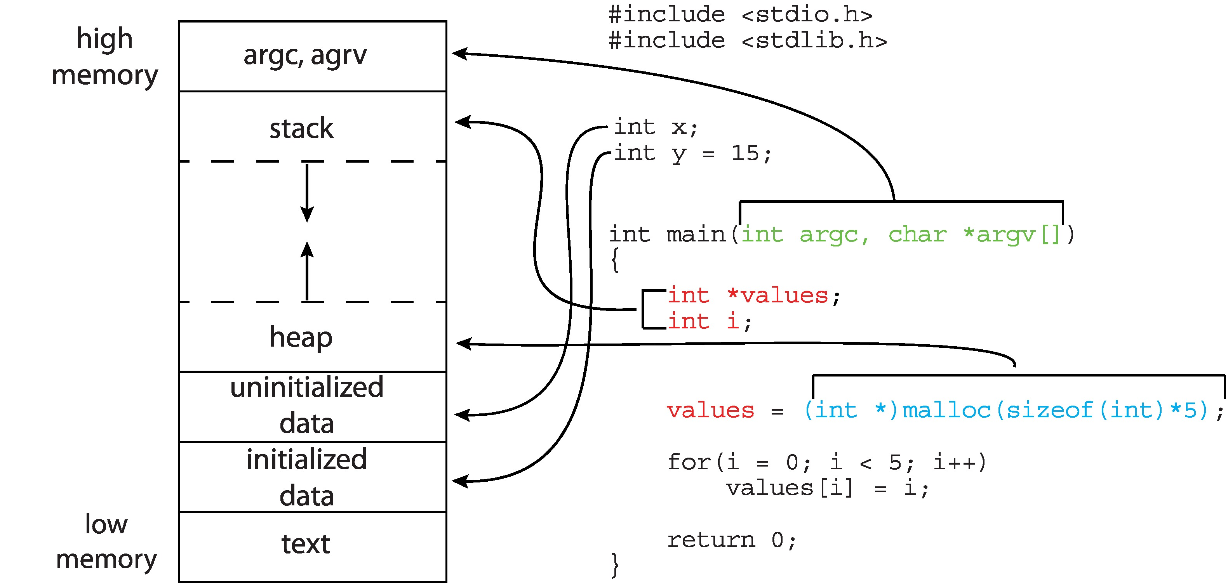
Process in Memory

Slide 7

Process State
As a process executes, it changes its state
  New: The process is being created
  Ready: The process is waiting to be assigned a processor
  Running: Instructions are being executed
  Waiting: The process is waiting for some event to occur
  Terminated: The process has finished execution

Slide 8
Example 1
Process | Burst Time | Start/Arrival Time
P1 | 40 sec | 0 sec
P2 | 40 sec | 0 sec
CPU time slice = 10 sec
Time Instant | P1 | P2
0
10
20
30
40
50
60
70
Running
Ready
Ready
Running
Running
Ready
Ready
Running
Running
Ready
Ready
Running
Running
Ready
-
Running

Slide 9
Example 2
Process | Burst Time | Start/Arrival Time
P1 | 30 sec | 0 sec
P2 | 50 sec | 0 sec
CPU time slice = 10 sec
Time Instant | P1 | P2
0
10
20
30
40
50
60
70
Running
Ready
Ready
Running
Running
Ready
Ready
Running
Running
Ready
-
Running
Running
Running

Slide 10
Example 3
Process | Burst Time | Start/Arrival Time
P1 | 40 sec | 0 sec
P2 | 40 sec | 0 sec
CPU time slice = 10 sec
P1 does an I/O for 10 sec at 20
P2 does an I/O for 20 sec at 40

Slide 11
Example 3
Process | Burst Time | Start/Arrival Time
P1 | 40 sec | 0 sec
P2 | 40 sec | 0 sec
CPU time slice = 10 sec
Time Instant | P1 | P2
0 | Running | Ready
10 | Ready | Running
20 | Blocked for I/O | Running
30 | Running | Ready
40 | Running | Blocked for I/O
50 | Running | Blocked for I/O
60 | Exit | Running
70 | - | Running
 |  | Exit

Slide 12
Example 4
Process | Burst Time | Start/Arrival Time
P1 | 40 sec | 0 sec
P2 | 40 sec | 0 sec
CPU time slice = 10 sec
P1 does an I/O for 10 sec at 20 and 50
P2 does an I/O for 10 sec at 40 and 60

Slide 13
Example 4
Process | Burst Time | Start/Arrival Time
P1 | 40 sec | 0 sec
P2 | 40 sec | 0 sec
CPU time slice = 10 sec
Time Instant | P1 | P2
0 | Running | Ready
10 | Ready | Running
20 | Blocked for I/O | Running
30 | Running | Ready
40 | Running | Blocked for I/O
50 | Blocked for I/O | Running
60 | Running | Blocked for I/O
70 | Exit | Running
 |  | Exit

Slide 14
Example 5:
Process | Burst Time | Start/Arrival Time
P1 | 30 sec | 0 sec
P2 | 40 sec | 0 sec
CPU time slice = 10 sec
P1 does an I/O for 10 sec at 20
P2 does an I/O for 30 sec at 30

Slide 15
Example 5
Process | Burst Time | Start/Arrival Time
P1 | 30 sec | 0 sec
P2 | 40 sec | 0 sec
CPU time slice = 10 sec
Time Instant | P1 | P2
0 | Running | Ready
10 | Ready | Running
20 | Blocked for I/O | Running
30 | Running | Blocked for I/O
40 | Running | Blocked for I/O
50 | Exit | Blocked for I/O
60 | - | Running
70 | - | Running
 |  | Exit

Slide 16

Process Control Block (PCB)
Information associated with each process(also called task control block)
Process Management Information
  Process state (running, ready, blocked, etc.)
  Program Counter & CPU registers, parents, etc.
  CPU scheduling information (priorities, etc.)
Memory Management Information
  memory allocated to the process (segments, page tables etc.)
I/O Status Information
  I/O devices allocated to process, list of open files etc.,
Accounting information
  CPU used, clock time elapsed since start, time limits

Slide 17
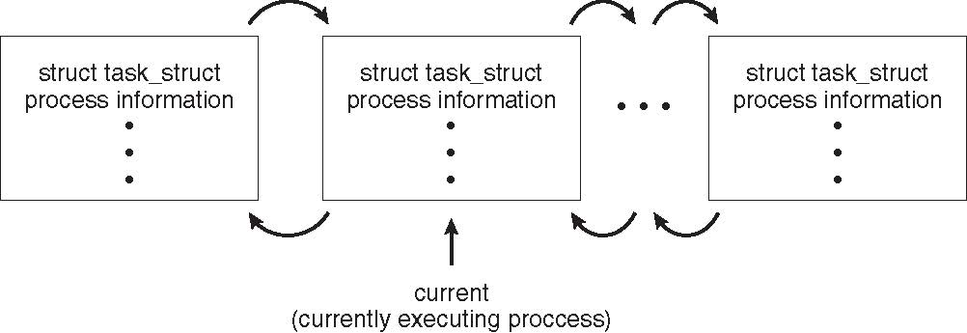
Process Representation in Linux
Represented by the C structure task_struct
pid t_pid; /* process identifier */
long state; /* state of the process */
unsigned int time_slice /* scheduling information */
struct task_struct *parent; /* this process’s parent */
struct list_head children; /* this process’s children *
struct files_struct *files; /* list of open files */
struct mm_struct *mm; /* address space of this process */

Slide 18
Process Scheduling
Processes in a system require CPU scheduling to execute concurrently
Process scheduler selects among available processes for next execution on the CPU core
Goal – Maximize CPU use, quickly switch processes onto CPU core

Slide 19
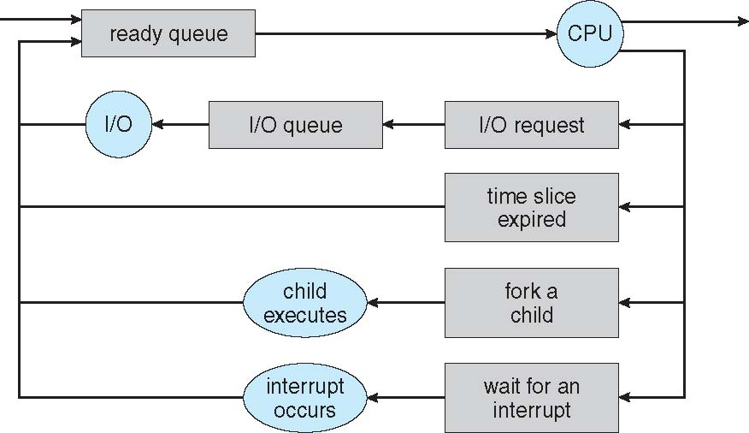
Process Scheduling
OS maintains scheduling queues of processes
  Job queue – set of all processes in the system
  Ready queue – set of processes residing in main memory, ready & waiting to execute
  Device queues – set of processes waiting for an I/O device
  Processes migrate among the various queues

Slide 20
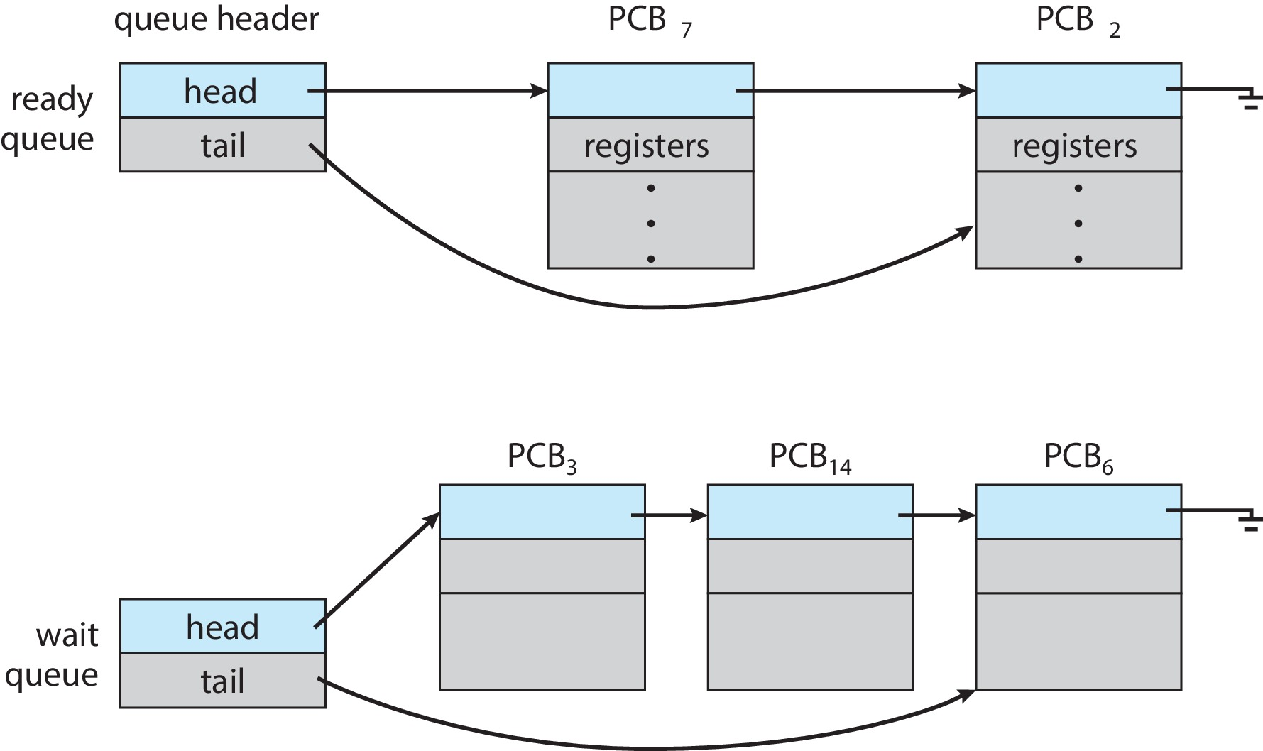
Ready and Wait Queues

Slide 21
Context Switch
A context switch occurs when the CPU switches from one process to another.
When CPU Switches to another process, the system must save the state of the old process and load the saved state for the new process via context switch
Context of a process is represented in the PCB
Context-switch time is pure overhead; the system does no useful work while switching. Much of the design of OS is to optimize the use of context switches.
Time dependent on hardware support.
  Some hardware provides multiple sets of registers per CPU → multiple contexts loaded at once
What about L1/L2 cache content?

Slide 22

Context Switch
The following steps are needed for a context switch to occur:
  Save the values of the program counter, registers, stack pointer.
  Change the process state in the PCB from running state to blocked state.
  Update the various times for process accounting information.
  Select a new process for execution.
  Update the state field in its PCB to running.
  Update memory management related information.
  Change the context of the CPU to the new process by loading the values of program counter and registers that were saved earlier.

Slide 23
Multitasking in Mobile Systems
Some mobile systems (e.g., early version of iOS) allow only one process to run, others suspended
Due to screen real estate, user interface limits iOS provides for a
  Single foreground process- controlled via user interface
  Multiple background processes– in memory, running, but not on the display, and with limits
  Limits include single, short task, receiving notification of events, specific long-running tasks like audio playback
Android runs foreground and background, with fewer limits
  Background process uses a service to perform tasks
  Service can keep running even if background process is suspended
  Service has no user interface, small memory use

Slide 24
Operations on Processes
System must provide mechanisms for:
  Process creation
  Process termination

Slide 25
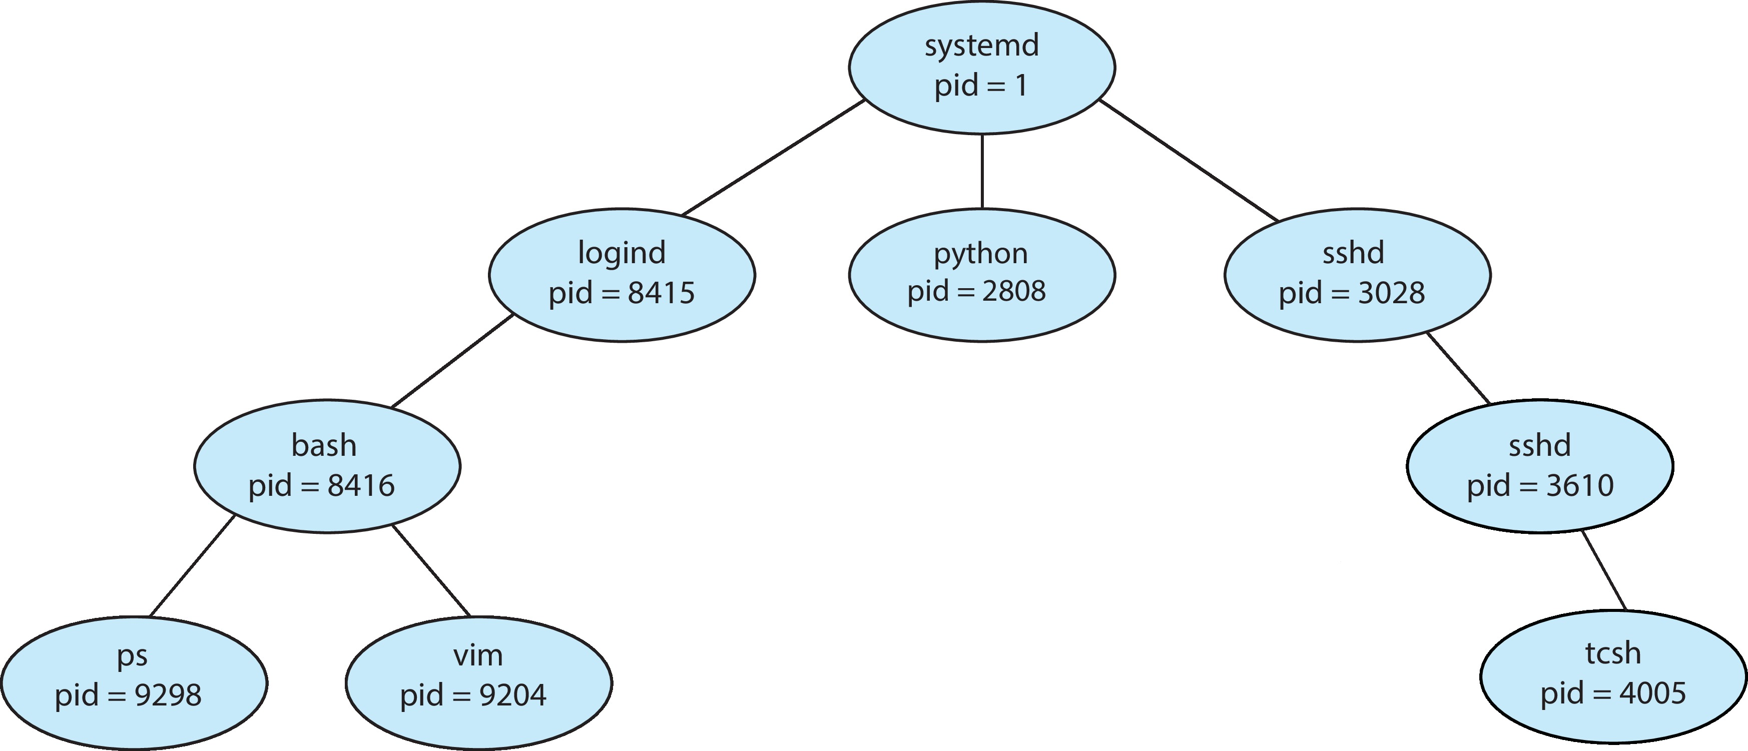
Process Creation
Parent process create children processes, which in turn create other processes, forming a tree of processes
Generally, process is identified and managed via a process identifier (pid)
Processes Tree on a UNIX System

Slide 26
Process Creation: Interface Design Options
Resource sharing options
  Parent and children share all resources
  Children share subset of parent’s resources
  Parent and children share no resources
Execution options
  Parent and children execute concurrently
  Parent waits until children terminate
Address space options
  Child duplicate of parent (code and data)
  Child has new program loaded into it

Slide 27
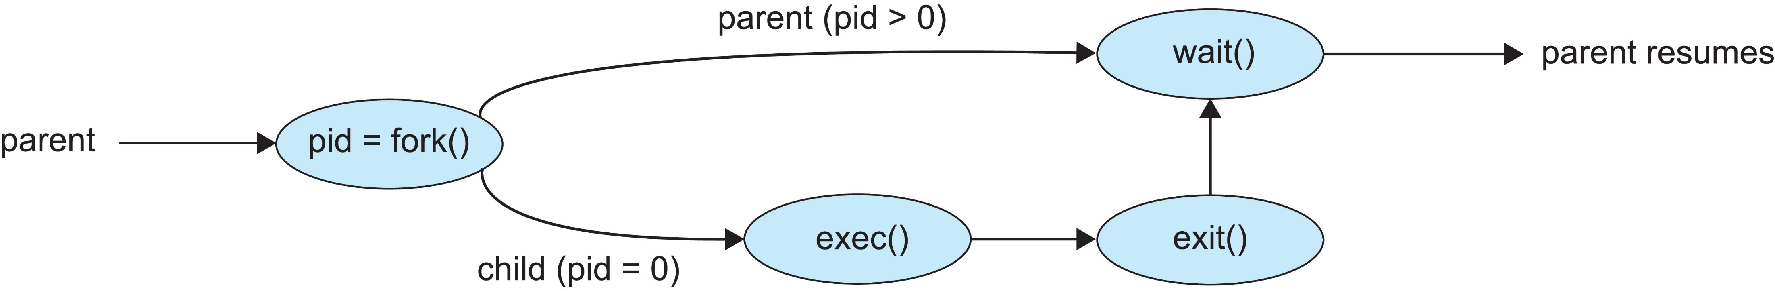
Process Creation: Unix
fork( ) system call creates a new process, duplicate of the original process
exec( ) system call, used after a fork ( ) to replace the process’ memory (code/address) space with a new program
Parent process calls wait( ) waiting for the child to terminate

Slide 28
Process Creation: fork ( )
main() {
...
foo();
...
I = fork()
}
foo() {
...
}
Process
main() {
...
foo();
...
I = fork()
}
foo() {
...
}
Process
Heap
Stack
main
foo
Heap
Stack
main
foo
Registers
Program Counter
Registers
Program Counter

Slide 29
Process Creation: exec (“b.out”)
// a.out
main() {
...
foo();
...
exec(“b.out”)
}
foo() {
...
}
Process
// b.out
main() {
}
Process
New Code
Code
Stack
main
foo
Data
Data
New Stack
Heap
Heap
Registers
Program Counter
Initialized
Registers
Program Counter
Afterwards, only one thing about the process was kept, what?

Slide 30
Forking a new Process
#include <stdio.h>
#include <sys/types.h>
#include <unistd.h>
int main() {
pid_t pid;
pid = fork(); /* fork a child process */
if (pid < 0) { /* error occurred */
fprintf(stderr, “Fork Failed");
return 1;
}
else if (pid == 0) { /* child process */
execlp("/bin/ls", "ls", NULL);
}
else { /* parent process */
wait(NULL); /* parent wait for the child to complete */
printf(“Child Complete”);
}
return 0;
}

Slide 31
Process Termination
Process executes last statement and asks the operating system to delete it using the exit( ) system call.
  Returns status data from child to parent (via wait( ))
  Process resources are de-allocated by the operating system.
The parent process may terminate execution of children processes (via abort( ))
  Child has exceeded allocated resources or task assigned to child no longer required
  The parent is exiting, and OSs does not allow a child to continue if its parent terminates
    cascading termination - All children, grandchildren, etc., are terminated, initiated by the OS
The parent process may wait for termination of a child process via pid = wait(&status);
  If no parent waiting (did not invoke wait( )), process is a zombie
  If parent terminated without invoking wait( ), process in an orphan
What happens when a parent process disappears?
  All child processes are killed by the OS, or all child processes reset init as their parent

Slide 32
Process Termination: Android
Mobile operating systems often have to terminate processes to reclaim system resources such as memory. Android will begin terminating processes that are least important in the following order:
  Empty process
  Background process
  Service process
  Visible process
  Foreground process

Slide 33

Multiprocess Architecture: Chrome Browser
Many web browsers ran as single process (some still do)
  If one web site causes trouble, entire browser can hang or crash
Google Chrome Browser is multiprocess with 3 different types of processes:
  Browser process manages user interface, disk and network I/O
  Renderer process renders web pages, deals with HTML, Javascript. A new renderer created for each website opened
    Runs in sandbox restricting disk and network I/O, minimizing effect of security exploits
  Plug-in process for each type of plug-in

